Slide 1
Circulating Fluidized Bed Boiler
Basic Engineering Design Data
Dowon SHUN
Korea Institute of Energy Research

Slide 2
Design specifications
Item | Unit | Value
Number of unit | - | 1
Type | - | One drum natural circulating fluidized bed coal combustion boiler with Dual cyclone and Single convection pass
Location | - | In door
Steam quality | - | Max/(Nominal)
Evaporation | ton/h | 105/(96)
Pressure at final super heater exit | bara | 67/(65)
Steam temperature | ℃ | 487/(487)
Power generation | MWe | 22
Average solid contents in final steam | ppm | 1.0
Average solid contents in drum | ppm | 750
Feed water at Ash cooler inlet | ℃ | 196/(192)
Steam temperature control range | ℃ | 477-487
Draft system |  | Balanced draft
Turn down ratio |  | 2 : 1
Ambient temperature | ℃ | 20
Reference relative humidity | % | 60

Slide 3
Terminal points
Drum
To Steam
Generator
Cyclone
S/H2
Hopper
S/H1
SDR
Scrubber
Combustor
Eco
Water
A/H
Ash cooler
Air
ID Fan
FD Fan
Stack

Slide 4
Emission targets
대기환경보전법 시행규칙 별표8 (2013)
고형연료 2000kg/h이상 전용시설
Parameter | Unit | Value
Sox | mg/Nm3(%O2) | 30(12)
Nox | mg/Nm3(%O2) | 70(12)
CO | mg/Nm3(%O2) | 50(12)
Particulates | mg/Nm3(%O2) | 20(12)
HCl | ppm(%O2) | 12
dioxine | TEQ | 0.1

Slide 5
Mass Balance

Slide 6
Mass Balance
Steam flow
Fuel
Limestone
Sand
Flue Gas
Boiler
Air
Ash
Water flow

Slide 7
Fuel analysis, wt %
(a)Proximate analysis[as received basis wt%]
(b)Ultimate analysis[dry basis wt%]
(c)Ash analysis[dry ash basis wt%]
Moisture | Volatile matters | Ash | Fixed carbon
0.56① | 9.65② | 1.11③ | 88.68④
C | H | N | S | HCl
85.52⑤ | 3.64⑥ | 1.94⑦ | ⑧ | ⑨
CaO | MgO | SO₃
1.01⑩ | 1.66⑪ | 0.58⑫

Slide 8
Fuel composition
Composition | Wt. % | Kg-mol/kg-fuel
CaO | (⑩-⑫/80.062x56.08)③%=0.01 | /58.06/100
MgO | ⑪x③%=0.02 | /40.312/100
CaSO4 | ⑫/80.062*136.14x③%=0.01
CO2 | (CaO/80.062 + MgO/40.312 – CaSO4/136.14)x44.0099 = 0.02
C | ⑤x(1-①%)-CO2/44.01x12.01=85.04
H | ⑥x(1-①%)=3.62
N | ⑦x(1-①%)=1.93
HCl | ⑨x(1-①%)=0
S | ⑧x(1-①%)-⑫x③%/80.062x32.064=5.34
H2O | ①=0.56
Inert | ③-CaO-MgO-CaSO4=1.07
O | 100-Σabove=2.39

Slide 9
Heating Value
Composition | Kcal/kg | KJ/kg
HHV | 80.84xC+344.768(H-O/8)+22.51xS= 34,055
LHV | HHV-54.02xH-6.17xH2O

Slide 10
Limestone analysis
(a)Moisture[as received basis wt%] : 0.22①
(b)Mineral analysis[dry basis wt%]
CaO | MgO | SO₃
52.4② | 0.09③ | ④

Slide 11
Component analysis of limestone
Composition | Wt % | Kg mol/kg fuel
Moisture | ①
CaO | ②(1-①/100) | /56/100
MgO | ③(1-①/100) | /40/100
CO2 | (CaO/56+MgO/40)*44 | (CaO/56+MgO/40)/100
SO3 | ④(1-①/100)/32*80 | ④/32/100
Others | 100-(CaO+MgO+CO2+SO3+Moisture)

Slide 12
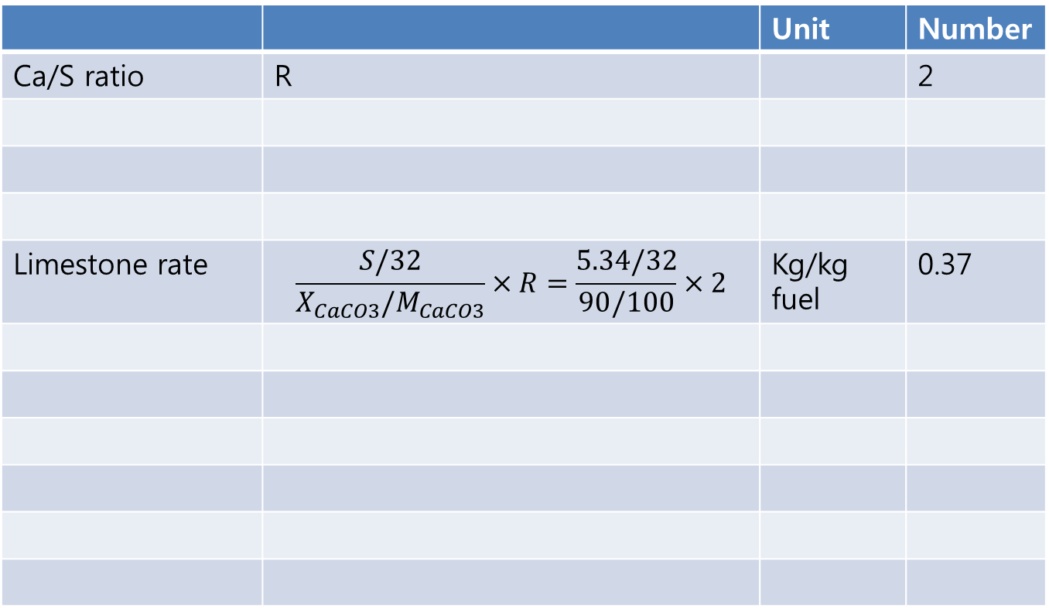
Limestone feed
 |  | Unit | Number
Ca/S ratio | R |  | 2
Limestone rate | $$\frac{S/32}{X_{CaCO3}/M_{CaCO3}}×R=\frac{5.34/32}{90/100}×2$$ | Kg/kg fuel | 0.37

Slide 13
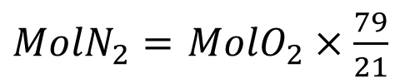
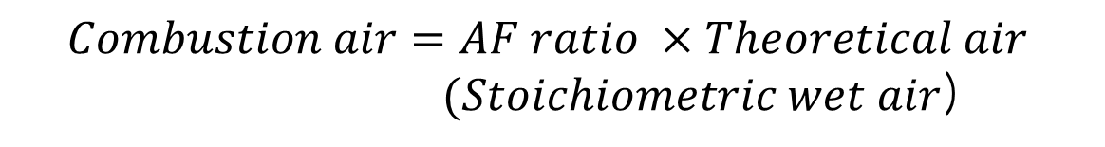
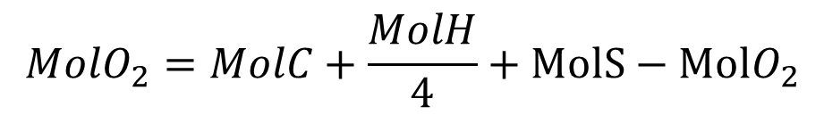
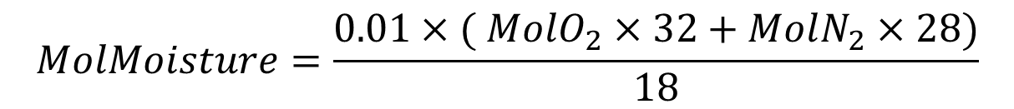
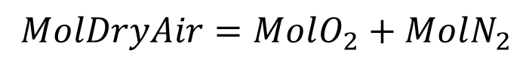
Air supply
$$MolO_{2}=MolC+\frac{MolH}{4}+MolS−MolO_{2}$$
$MolN_{2}=$ $MolO_{2}×\frac{79}{21}$
$$MolDryAir=MolO_{2}+MolN_{2}$$
$$MolMoisture=\frac{0.01×( MolO_{2}×32+MolN_{2}×28)}{18}$$
$$Theoretical air=MolDryAir+MolMoisture$$
$$Combustion air=AF ratio ×Theoretical air$$
$(Stoichiometric wet air$)

Slide 14
Combustion air
Primary air; Fluidizing air
Secondary air + Loop seal air
Both considered as secondary air
SNCR injection air (negligible)

Slide 15
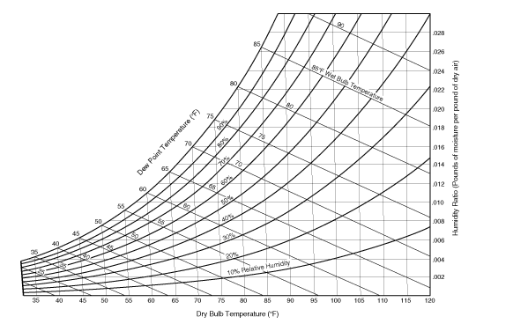
Humidity

Slide 16
Design example – Air supply
Item |  | Unit | Value
A/F ratio |  | - | 1.2
Theoretical O2 | C: 85.04/100/12*32 | kg/kg-fuel
 | H: 3.62/100/4*32
 | S: 5.34/100/32*32
 | O2: -2.39/100/32*32
<sum> |  |  | 2.58
Theoretical N2 | 2.58/32*79/21*28 |  | 8.50
Theoretical dry air | 2.58+8.50 |  | 11.09
Moisture in air | 11.09*0.013 |  | 0.14
Theoretical air | 11.09 + 0.14 |  | 11.23
Combustion air | 1.2*11.23 |  | 13.48

Slide 17
Air leak
Air leak from the environment to system is inevitable.
The combustor is operated under negative pressure, i.e., the pressure at the combustor exit is -10mmH2O,
I.D. fan inlet negative pressure is around -500mmH2O,
However air leak can be significantly reduced using modern sealing material and manufacturer’s skill.

Slide 18
Air leak
Section |  | Max. Leakage, ratio to stoichiometric air
Combustor | Dense bed | 0
 | Freeboard | 0 ~ 0.1
Convection pass | Super heater | 0 ~ 0.05
 | Economizer | 0.1 ~ 0.15
Air heater |  | 0 ~ 0.1
Bag filter/ESP |  | 0.1 ~ 0.15
Duct after air heater |  | ~ 0.01/10m duct

Slide 19
Flue gas
Mole CO2 +SO2
Mole N2 in air
Mole H2O in fuel
Mole H2O in air
Mole O2 = (AF – 1) x Theoretical O2

Slide 20
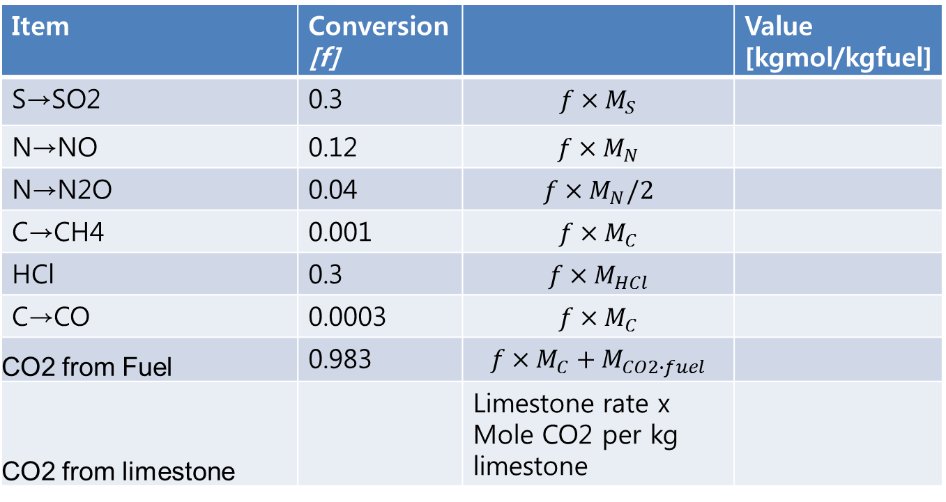
Flue gas at combustor exit
Item | Conversion [f] |  | Value [kgmol/kgfuel]
S→SO2 | 0.3 | $$f×M_{S}$$
N→NO | 0.12 | $$f×M_{N}$$
N→N2O | 0.04 | $$f×M_{N}/2$$
C→CH4 | 0.001 | $$f×M_{C}$$
HCl | 0.3 | $$f×M_{HCl}$$
C→CO | 0.0003 | $$f×M_{C}$$
CO2 from Fuel | 0.983 | $$f×M_{C}+M_{CO2∙fuel}$$
CO2 from limestone |  | Limestone rate x Mole CO2 per kg limestone

Slide 21
Flue gas at combustor exit
Item | Conversion [f] |  | Value [kgmol/kgfuel]
H2O from Fuel H |  | Mole H/2-Mole CH4x2-Mole HCl/2
H2O from Fuel Moisture |  | Mole H2O in fuel
H2O from air |  | Mole % moisture x Mole air
N2 |  | Mole % N2 x Mole air
O2 |  | Mole % O2 x Mole air Mole CO2 Mole CO/2 Mole H2O from Fuel/2 Mole SO2 Mole NO/2 Mole CaSO4/2 Mole N2O/4

Slide 22
Mass balance
Item |  | Unit | Number
Fuel feed | 45x1000x3600/34055 | Kg/h | 4757
Sorbent feed |  | Kg/h | 1000
Air flow | 13.48x4757 | Kg/h
Flue gas | 14.59x4757
Fly ash flow | 0.8x(0.11x4757+0.5887x1000)
Bottom ash flow | 0.2x(0.11x4757+0.5887x1000)

Slide 23
Heat Balance

Slide 24
Heat balance in combustor
Latent Moisture
Fuel combustion
Fuel specific
Radiation loss
Incoming air
Flue gas & Fly ash
Bed ash drain

Slide 25
Heat Balance
Steam Enthalpy
CBD
Flue gas heat content
Moisture latent heat in fuel
Unburned loss(C, CH4, CO)
Radiation Heat loss
Bottom ash loss
Fuel heating value
Fuel specific heat
Air specific heat
Boiler
Water Enthalpy
De super heater Enthalpy

Slide 26
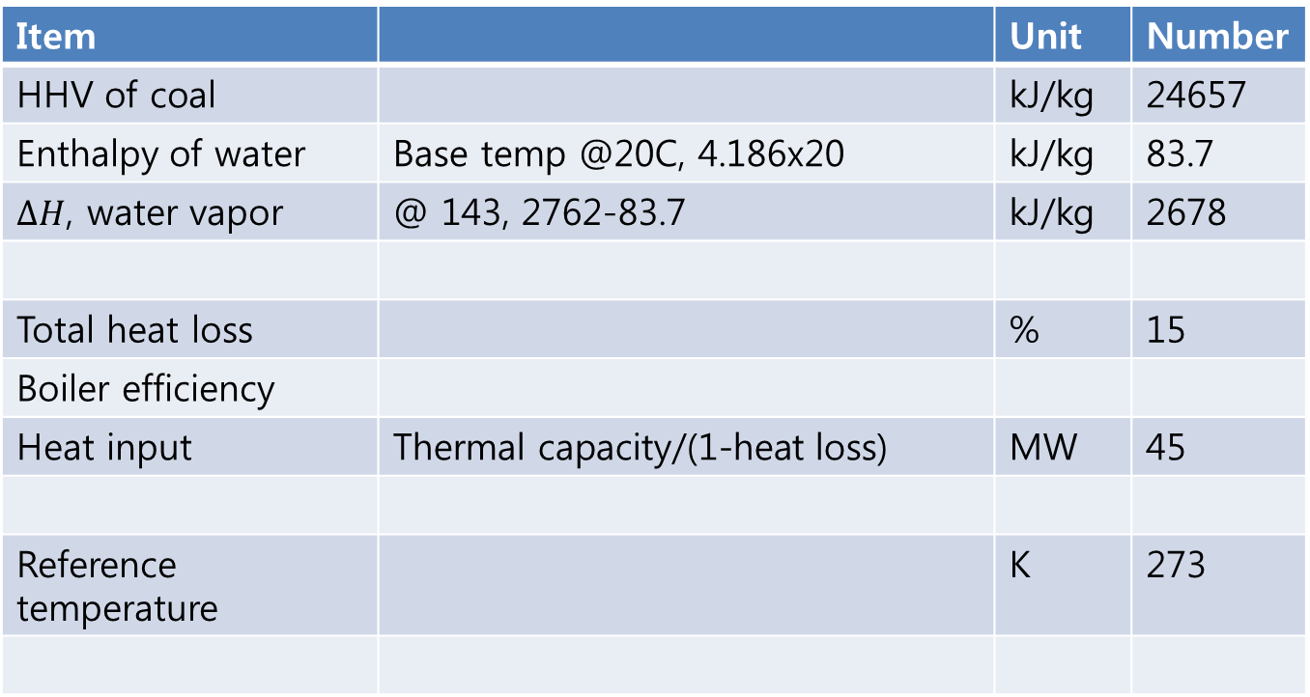
heat balance
Item |  | Unit | Number
HHV of coal |  | kJ/kg | 24657
Enthalpy of water | Base temp @20C, 4.186x20 | kJ/kg | 83.7
$∆H$, water vapor | @ 143, 2762-83.7 | kJ/kg | 2678
Total heat loss |  | % | 15
Boiler efficiency
Heat input | Thermal capacity/(1-heat loss) | MW | 45
Reference temperature |  | K | 273

Slide 27
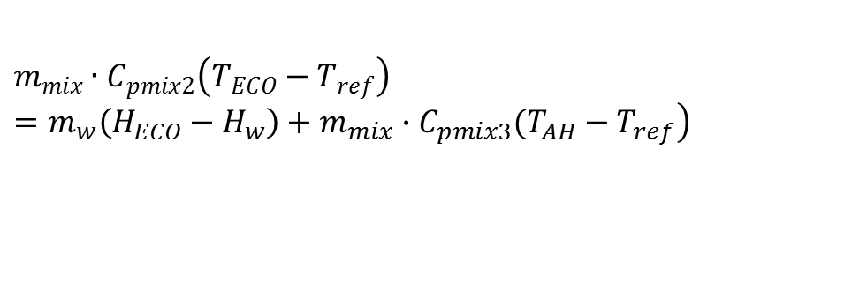
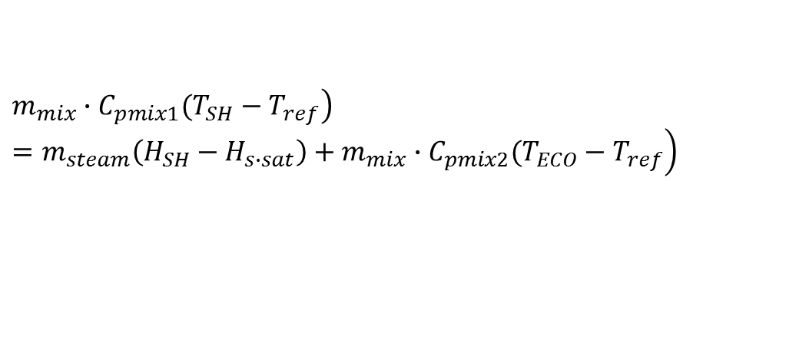
Heat balance calculation
Measure flue gas T_{ECO} downstream
$$Q_{air, A}{=m}_{air}×C_{p, air}×\left(T_{out, air}−T_{in, air}\right)$$
$$Q_{fuel}+Q_{air}−Q_{BA}=m_{w}(H_{s∙sat}−H_{EC0})+ m_{mix}∙C_{pmix1}(T_{SH}−T_{ref})$$
$$\left.\left.m_{mix}∙C_{pmix1}(T_{SH}−T_{ref}\right) =m_{steam}\left(H_{SH}−H_{s∙sat}\right)+m_{mix}∙C_{pmix2}(T_{ECO}−T_{ref}\right)$$
$$\left.m_{mix}∙C_{pmix2}\left(T_{ECO}−T_{ref}\right)=m_{w}\left(H_{ECO}−H_{w}\right)+m_{mix}∙C_{pmix3}(T_{AH}−T_{ref}\right)$$
T_{ECO} = T_{AH}

Slide 28
Combustion
C + O2 -> CO2 + 32790kJ/kg carbon
S + O2 -> SO2 + 9260kJ/kg S

Slide 29
Combustion
C + O2 → CO2 + 32790kJ/kg carbon
S + O2 → SO2 + 9260kJ/kg S
H2 + 1/2O2 → H2O(ㅣ) + 15,879 kg H2O
Fuel heating value different from the heat of combustion of component

Slide 30
Chemical reaction
CaCO3 -> CaO + CO2 - 1830kJ/kg CaCO2
MgCO3 -> MgO + CO2 - 1183kJ/kg MgO
CaO + SO2 + 1/2O2 -> CaSO4 +15141kJ/kgS

Slide 31
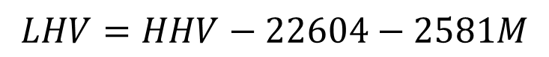
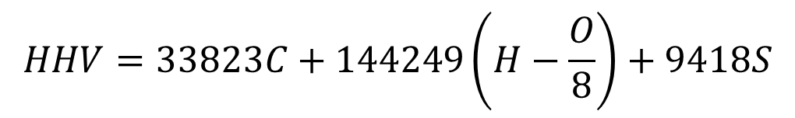
Heating value of fuel
$$HHV=33823C+144249\left(H−\frac{O}{8}\right)+9418S$$
kJ/kg
$$LHV=HHV−22604−2581M$$
kJ/kg

Slide 32
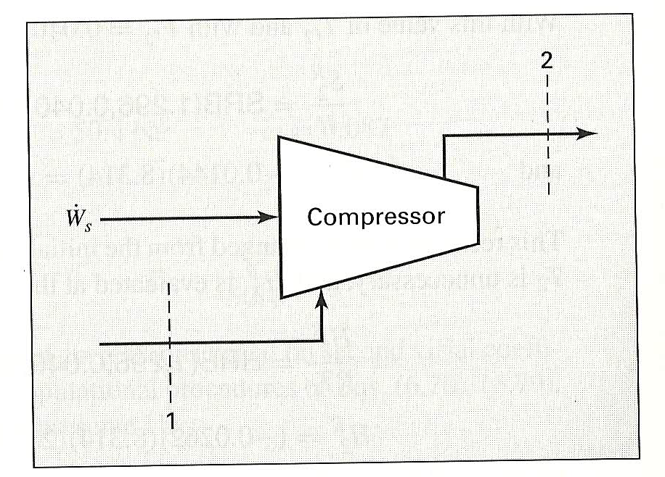
Fan credit
Primary Air is compressed from -50mmaq to 2000mmaq

Slide 33
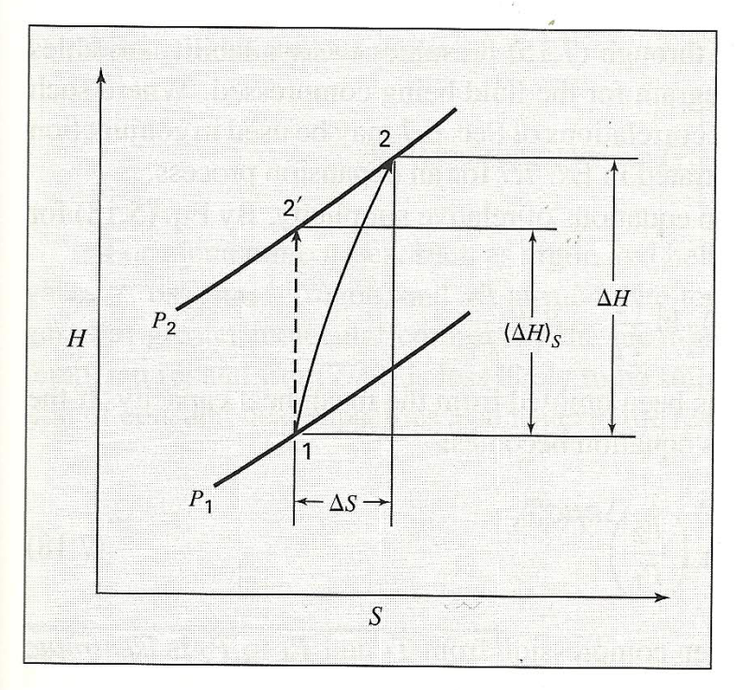
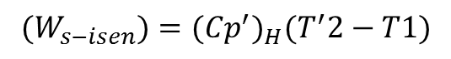
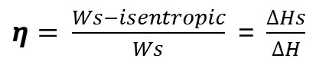
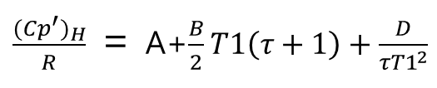
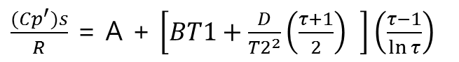
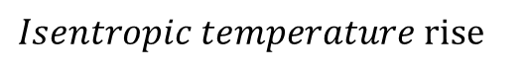
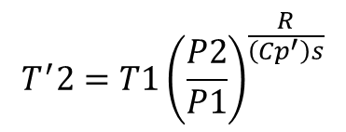
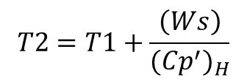
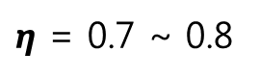
Fan credit by compression of air
$Isentropic temperature rise$
$$T^{′}2=T1{\left(\frac{P2}{P1}\right)}^{\frac{R}{\left({Cp}^{′}\right)s}}$$
Mean Heat Capacity over R to Entropy
$\frac{{(Cp}^{′})s}{R}$ = A + $\left[BT1+\frac{D}{{T2}^{2}}\left(\frac{τ+1}{2}\right) \right]\left(\frac{τ−1}{\ln{τ}}\right)$
Mean Heat Capacity over R to Enthalpy
$\frac{{{(Cp}^{′})}_{H}}{R}$ = A+$\frac{B}{2}T1\left(τ+1\right)+\frac{D}{τ{T1}^{2}}$
Isentropic Enthalpy variation
$η= \frac{Ws−isentropic}{Ws}$ = $\frac{∆Hs}{∆H}$
$${(W}_{s−isen})={{(Cp}^{′})}_{H}(T^{′}2−T1)$$
$$\left(Ws\right)=\frac{{(W}_{s−isen})}{η}$$
$η$ = 0.7 ~ 0.8
$$T2=T1+\frac{\left(Ws\right)}{{{(Cp}^{′})}_{H}}$$

Slide 34
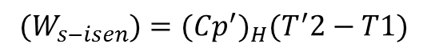
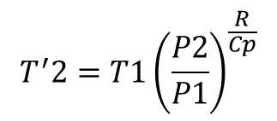
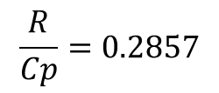
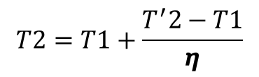
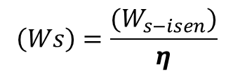
For Ideal gas considerton
SVN 6/e P270~271
<Cp′>_{H} = <Cp>′_{S}= Cp
$$T^{′}2=T1{\left(\frac{P2}{P1}\right)}^{\frac{R}{Cp}}$$
$$\frac{R}{Cp}=0.2857$$
For air at moderate tempearture
$${(W}_{s−isen})={{(Cp}^{′})}_{H}(T^{′}2−T1)$$
$$\left(Ws\right)=\frac{{(W}_{s−isen})}{η}$$
$$T2=T1+\frac{T^{′}2−T1}{η}$$

Slide 35
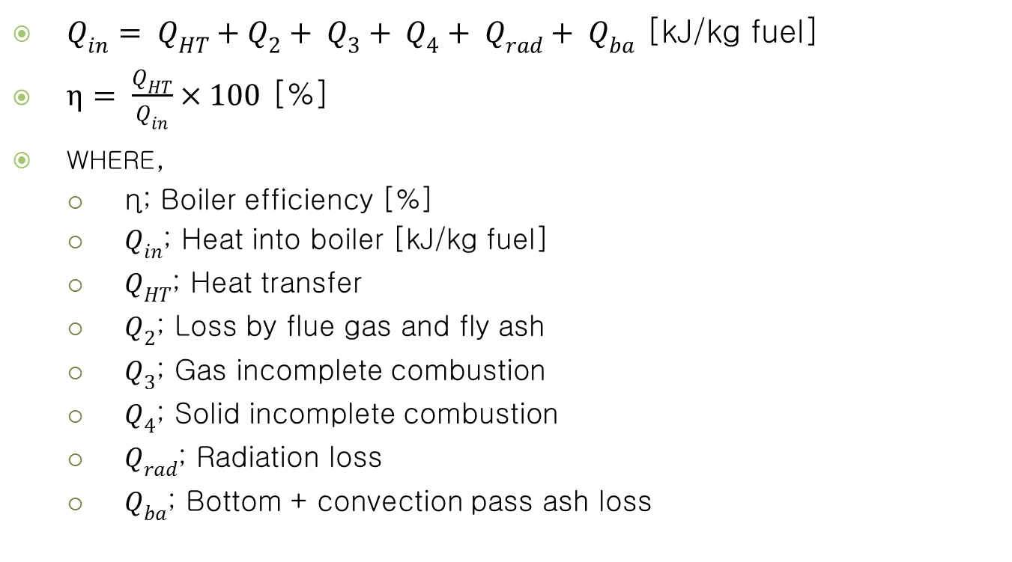
Boiler efficiency
$Q_{in}= Q_{HT}+Q_{2}+ Q_{3}+ Q_{4}+ Q_{rad}+ Q_{ba}$ [kJ/kg fuel]
$η= \frac{Q_{HT}}{Q_{in}}×100$ [%]
where,
η; Boiler efficiency [%]
$Q_{in}$; Heat into boiler [kJ/kg fuel]
$Q_{HT}$; Heat transfer
$Q_{2}$; Loss by flue gas and fly ash
$Q_{3}$; Gas incomplete combustion
$Q_{4}$; Solid incomplete combustion
$Q_{rad}$; Radiation loss
$Q_{ba}$; Bottom + convection pass ash loss

Slide 36
Boiler Efficiency
Item |  | Unit | Number
Loss, moisture in sorbent | - 0.37x0.0022x2678/34055x100 | % | - 0.0064
Loss, moisture in fuel | - 1x0.0056x2678/34055x100 | % | - 0.044
Calcination, CaCO3 | - 0.37x93.4%x1830/34055x100 | % | - 1.86
Calcination, MgCO3 | - 0.37x0.19%x1183/34055/100 | % | - 0.002
Sulfation credit | 90%x0.0534x15141/34055x100 | % | 2.14
Unburnt loss | - 2.0% | % | - 2.0
Heat, flue gas | -14.59x1.03x(150-20)/34055x100 | % | - 5.74
Hydrogen in fuel | - 0.0362/2x18x2678/34055x100 | % | - 2.56
Ash loss | -0.011x20%x0.84x(850-20)/34055x100 | % | - 0.0045
Other loss | Set | % | - 1.5

Slide 37
Heat Transfer

Slide 38
Furnace data
Item |  | Unit | Number
Cross. Release rate | Set | MW/m2 | 3.5
Upper cross sect. | 45/3.5 | m2 | 13
Upper gas velocity | V <= 5m/s | m/s
Lower cross sect. | Up. Sect. x Pri. Air frac.

Slide 39
Water/steam conditions
 | ata | C | kJ/kg
Feed water | 54 | 143 | 601
Economizer out | 52 | 250 | 1084
Sat. steam | 50 | 264 | 2802
LT Super heater out | 47 | 379 | 3170
HT Super heater in | 47 | 356 | 3118
Steam | 45 | 450 | 3326

Slide 40
Boiler duty
Items |  | Unit | Number
Thermal capacity |  | MW | 39
Water rate | 39*1000*3600/(3326-601) | Kg/h | 50000
Economizer | (1084-601)x50000/3600 | MW | 6.7
Evaporator | (2802-1084)x50000/3600 | MW | 23.9
Super heater | (3326-2802)x50000/3600 | MW | 8

Slide 41
Water wall
Item |  | Unit | Number
Evaporator duty |  | MW | 23.9
Gas temp | To | C | 850
Water temp | Tsat | C | 264
Temp difference | 850-264 | C | 586
Heat transfer co. | Uo | W/m2K | 150
Q |  | kW | 23900
Eva. area | A = Qwall/(Uox(To-Tsat)) | m2 | 272

Slide 42
Departure from Nucleate Boiling(DNB)

Slide 43
Air heater
Air heater duty |  | MW | 8
Gas temp. up |  | C | 850
Gas temp. down |  | C | 500
Air temp. in |  | C | 264
Air temp. out |  | C | 450
Del T log | (850-450)-(500-264)/ln((850-450)/(500-264)) | C | 310
Heat tansfer co. | Uo | kW/m2K | 0.05
Q |  | kW | 8000
Area | q/(Uo X del T log) | m2 | 516

Slide 44
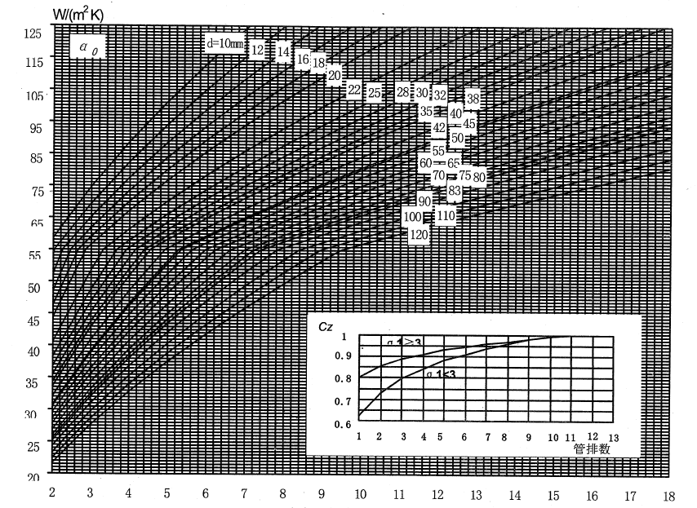
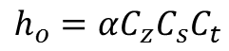
Air heater ho - Graphical method
$$h_{o}=αC_{z}C_{s}C_{t}$$
[W/m2-K]
Gas velocity, m/s

Slide 45
Ct
Gas temperature, ℃
Cs
σ1

Slide 46
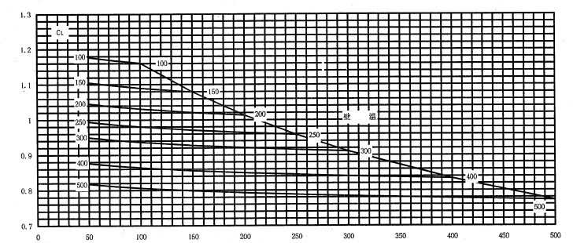
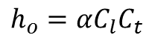
Graphical method - Air heater hi
$$h_{o}=αC_{l}C_{t}$$
[W/m2-K]
α
Ct
Gas temperature, ℃
Gas velocity, m/s

Slide 47
Economizer
Economizer duty |  | MW | 6.7
Gas temp. up |  | C | 500
Gas temp. down |  | C | 250
Water temp. in |  | C | 143
Water temp. out |  | C | 245
Del T log | (500-245)-(250-143)/ln((500-245)/(250-143)) | C | 170
Heat tansfer co. | Uo | kW/m2K | 0.05
Q |  | kW | 6700
Area | q/(Uo X del T log) | m2 | 905

Slide 48
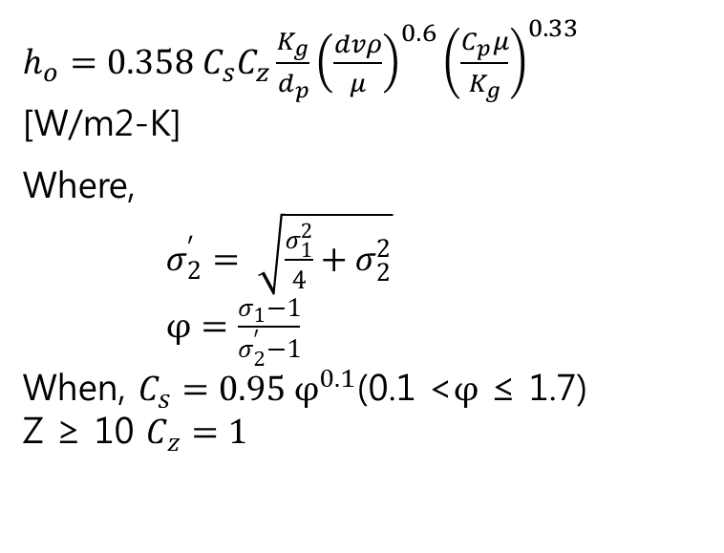
Heat transfer coefficient of Economizer
$h_{o}=0.358 C_{s}C_{z}\frac{K_{g}}{d_{p}}{\left(\frac{dvρ}{μ}\right)}^{0.6}{\left(\frac{C_{p}μ}{K_{g}}\right)}^{0.33}$ [W/m2-K]
Where,
$σ_{2}^{′}= \sqrt{\frac{σ_{1}^{2}}{4}+σ_{2}^{2}}$
$φ=\frac{σ_{1}−1}{σ_{2}^{′}−1}$
When, $C_{s}=0.95 φ^{0.1}$(0.1 <$φ$ ≤ 1.7)
Z ≥ 10 $C_{z}=1$
S1
d
S2’
S2
Z

Slide 49
Super heater
Super heater duty |  | MW | 8
Gas temp. up |  | C | 850
Gas temp. down |  | C | 500
Steam temp. in |  | C | 264
Steam temp. out |  | C | 450
Del T log | (850-450)-(500-264)/ln((850-450)/(500-264)) | C | 310
Heat tansfer co. | Uo | kW/m2K | 0.05
Q |  | kW | 8000
Area | q/(Uo X del T log) | m2 | 516

Slide 50
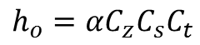
Gas phase ho - Graphical
$$h_{o}=αC_{z}C_{s}C_{t}$$
[W/m2-K]

Slide 52
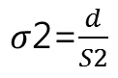
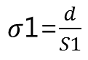
Super heater tube bundle
$σ$1=$\frac{d}{S1}$
d
S1
$σ$2=$\frac{d}{S2}$
S2
Z

Slide 53
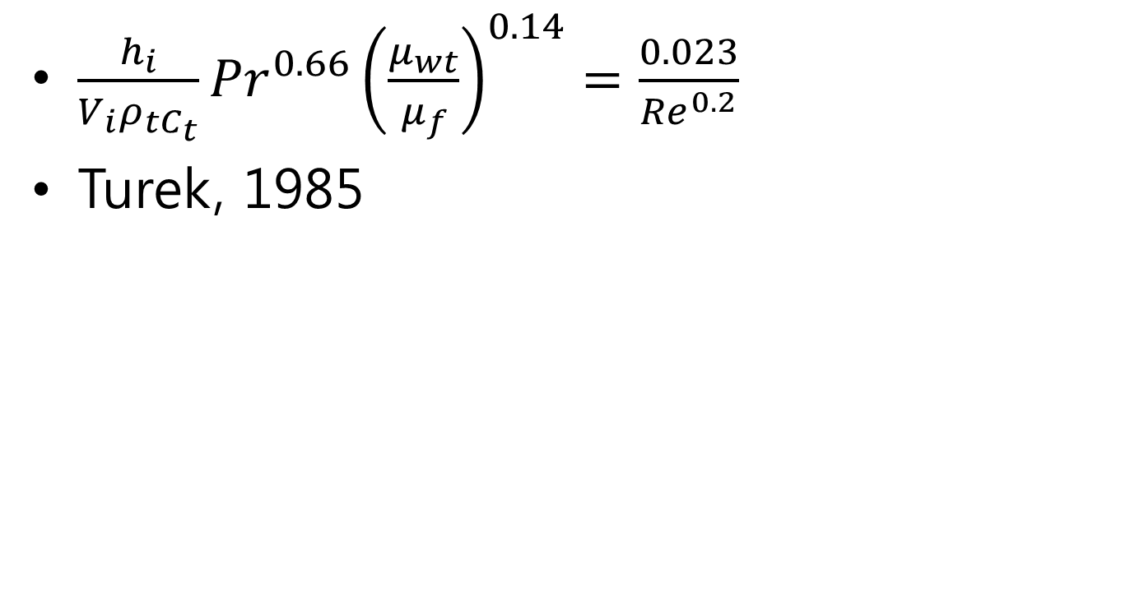
Tube-to –steam hi
$\frac{h_{i}}{V_{i}ρ_{tC_{t}}}{Pr}^{0.66}{\left(\frac{μ_{wt}}{μ_{f}}\right)}^{0.14}=\frac{0.023}{{Re}^{0.2}}$
Turek, 1985

Slide 54
Water side pressure drop
V. Ganapathy. Industrial Boiers and Heat Recovery Steam Generators:
Chapter 7, CRC Press, NW 2003.

Slide 55
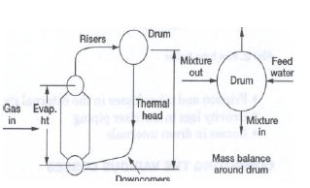
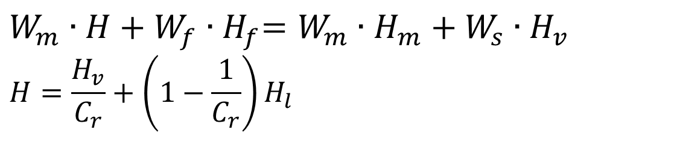
Drum - heat balance
Ws, Hv
Wf, Hf
Wm, H
Wm, Hm
$W_{m}∙H+W_{f}{∙H}_{f}=W_{m}∙H_{m}+W_{s}∙H_{v}$
$$H=\frac{H_{v}}{C_{r}}+\left(1−\frac{1}{C_{r}}\right)H_{l}$$

Slide 56
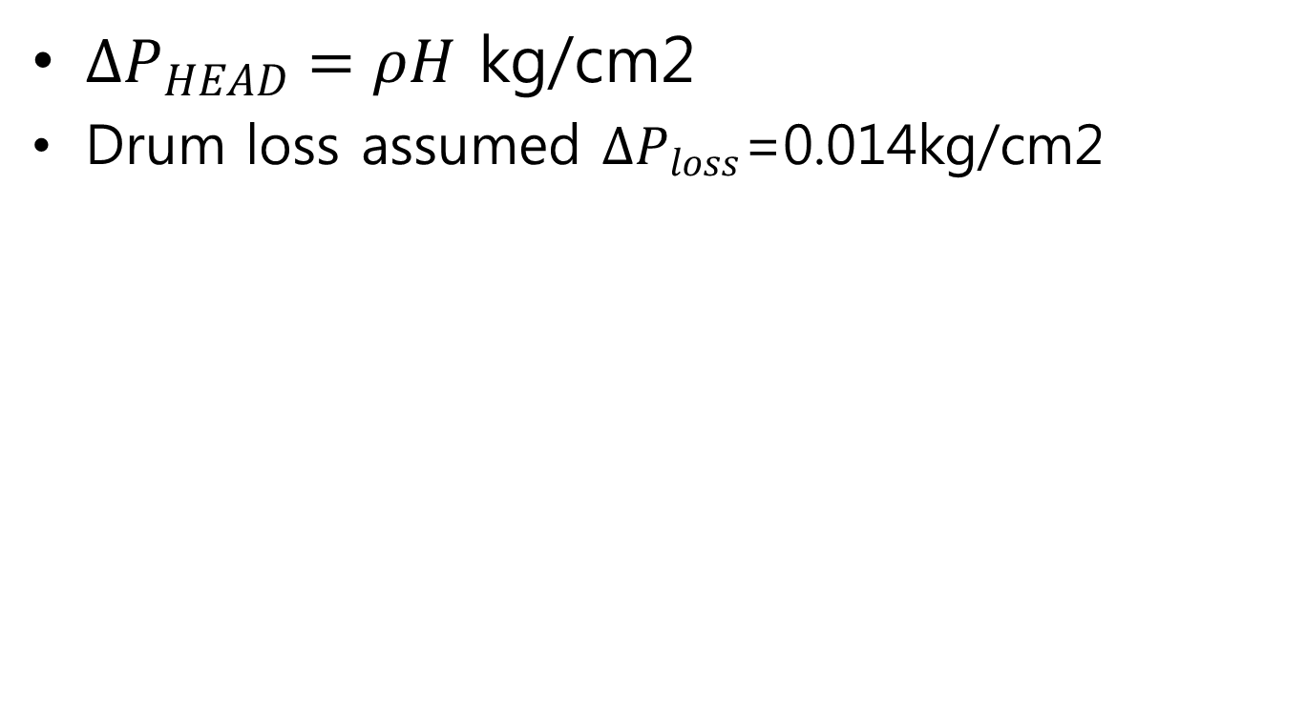
Zone ①
$∆P_{HEAD}=ρH$ kg/cm2
Drum loss assumed $∆P_{loss}$=0.014kg/cm2

Slide 57
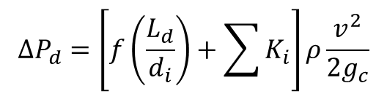
Zone② Down Comer
Friction loss
Ld; down comer height
+ supplier length
In/out and fitting loss coefficient, K
$$∆P_{d}=\left[f\left(\frac{L_{d}}{d_{i}}\right)+\sum{K_{i}}\right]ρ\frac{v^{2}}{2g_{c}}$$

Slide 58
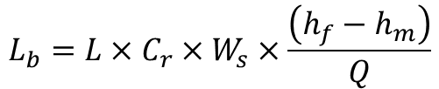
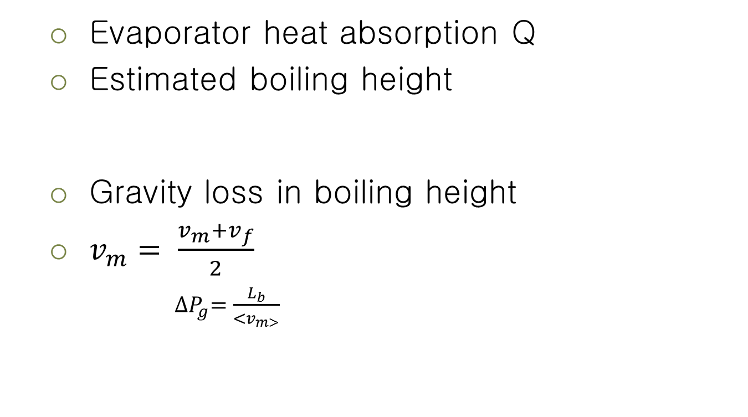
Zone③-1 Evaporator boiling height
Evaporator heat absorption Q
Estimated boiling height
Gravity loss in boiling height
$v_{m}= \frac{v_{m}+v_{f}}{2}$
${∆P}_{g}=\frac{L_{b}}{{<v}_{m>}}$
$$L_{b}=L×C_{r}×W_{s}×\frac{\left(h_{f}−h_{m}\right)}{Q}$$

Slide 59
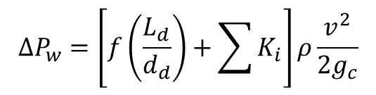
Zone③-1
Friction loss in boiling height
f; darcy friction factor
In/out and fitting loss factor Ki
$$∆P_{w}=\left[f\left(\frac{L_{d}}{d_{d}}\right)+\sum{K_{i}}\right]ρ\frac{v^{2}}{2g_{c}}$$

Slide 60
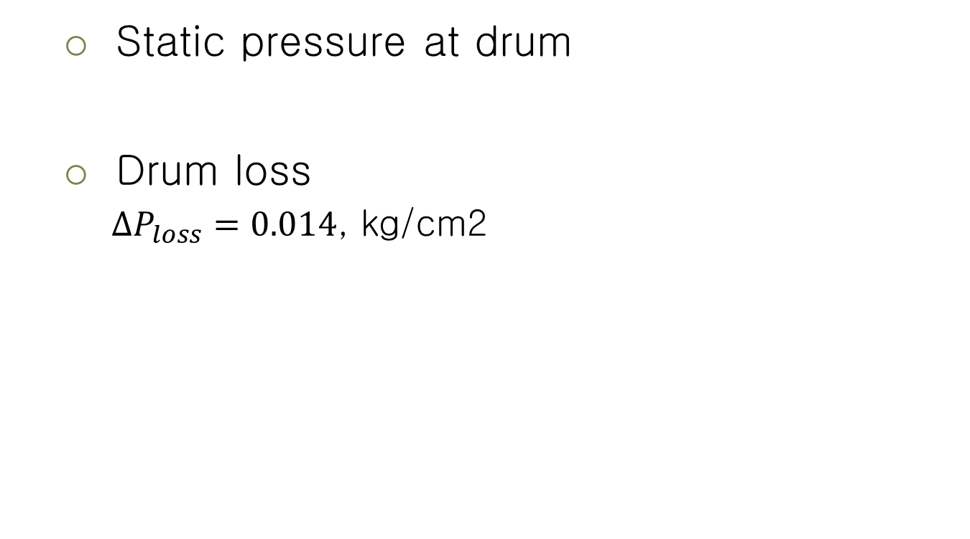
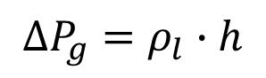
Zone① Drum - pressure balance
Static pressure at drum
Drum loss
$∆P_{loss}=0.014$, kg/cm2
$$∆P_{g}=ρ_{l}∙h$$

Slide 61
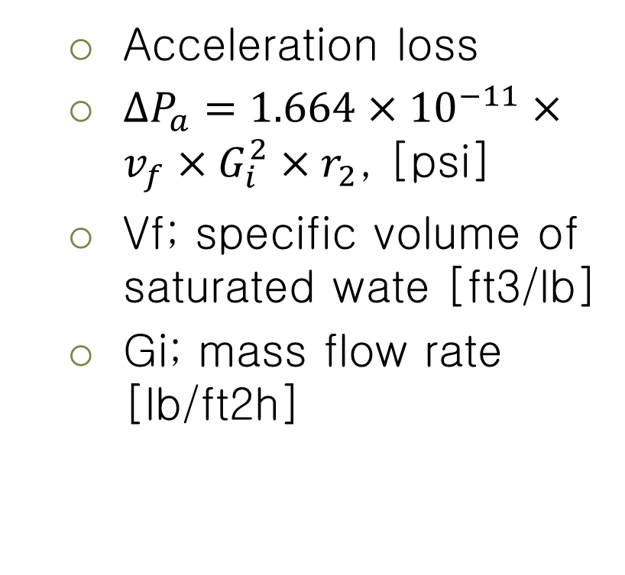
Zone③-2 Two phase loss where bubble and liquid co exist
Acceleration loss
$∆P_{a}=1.664×{10}^{−11}×v_{f}×G_{i}^{2}×r_{2}$, [psi]
Vf; specific volume of saturated wate [ft3/lb]
Gi; mass flow rate [lb/ft2h]

Slide 62
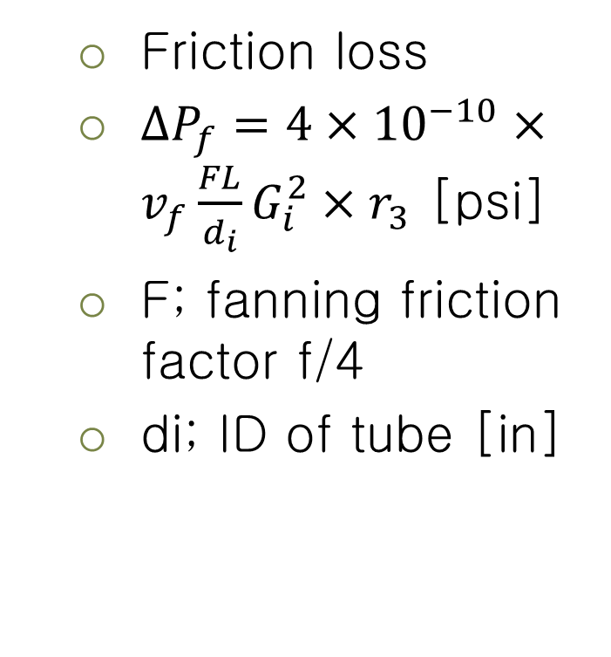
Zone③-2
Friction loss
$∆P_{f}=4×{10}^{−10}×v_{f}\frac{FL}{d_{i}}G_{i}^{2}×r_{3}$ [psi]
F; fanning friction factor f/4
di; ID of tube [in]

Slide 63
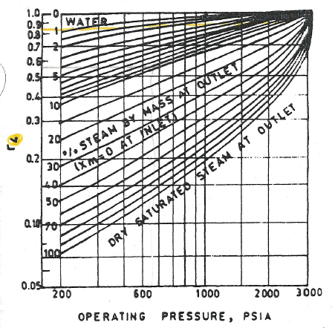

Zone③-2
Gravity loss
$∆P_{g}=6.944×{10}^{3}×L\frac{r_{4}}{v_{f}}$[psi]

Slide 64

Zone④ Riser- unheated tubes
$∆P_{f}=f\frac{L}{(\frac{di}{12})}\frac{V_{f}^{2}}{\left(2g_{c}∙v_{f}\right)}\frac{r_{f}}{144}$[psi]
Vm; mixture velocity in riser
$∆P_{g}=\left[\frac{(1−α)}{v_{f}}+\frac{α}{v_{g}}\right]\frac{L}{144}$ [psi]

Slide 65
Zone④
Α; void fraction

Slide 66

Drum circulation calculaton
$∆P_{HEAD}−∆P_{loss}− {∆P}_{g}−∆P_{w}−∆P_{a}−∆P_{ac}−∆P_{af}−∆P_{ag}−∆P_{ff}−∆P_{fg}=0$-
First assume circulation rate (Cr) calculate Hm then Calculate total of pressure drop. If it does not converge to zero adjust circulation rate (Cr).

Slide 67
Tube pressure drop
Economizer → Drum → Wall Super heater → Coil superheater 1 → coil superheater 2

Slide 68
Economizer pressure drop
Economizer
Water line pressure drop
Headers
Height from the bottom of feeder line to drum
Hanger tubes
Feeder line to drum

Slide 69
Super heater pressure drop
Steam line pressure drop
Headers

Slide 70
De-super heater pressure drop
Pressure drop due to mixing of water and steam in Attempretor(de-super heater) chamber 0.5~1atm

Slide 71
Boiler circuit
50 bar
45 bar
14 bar
0.1 bar
Super heater
45°C
263°C
450°C
190°C
Power
De-super heater
Drum
143°C
ECO
Evaporator
Deaerator
Condenser
Pump

Slide 72

Main condenser pump

Slide 73

De-aerator

Slide 74
Feed Water Pressure
Pump discharge pressure > Tube pressure drop + margin

Slide 75

Feed water pump & Heater

Slide 76


Feed water pump
$$P_{pump }= ∆P_{FWV}+∆P_{ECO}+∆P_{DRUM}+∆P_{SH}+P_{steam}$$
Where,
$P_{pump }$; pump discharge pressure [bar]
$∆P_{FWV}$; Feed water valve pressure drop including pipeline pressure drop [bar]
$∆P_{ECO}$; Economizer pressure drop including pipeline pressure drop [bar]
$∆P_{DRUM}$; Drum pressure drop [bar]
$∆P_{SH}$; Super heater pressure drop [bar]
$P_{steam}$; Discharge pressure of steam

Slide 77

Water/Stem line pressure drop
𝐿𝑖𝑛𝑒 𝑝𝑟𝑒𝑠𝑠𝑢𝑟𝑒 𝑑𝑟𝑜𝑝; $∆P=f(\frac{L}{di})ρ\frac{V^{2}}{2g_{c}}$
f; Darcy friction factor
Local pressure drop; $∆P=Kρ\frac{V^{2}}{2g_{c}}$
K; loss coefficient

Slide 78

Friction coefficient (f)
Laminar flow (Re≤2100)
$f=64/Re$
Boundary flow (2100 ≤ Re ≤ 3500din/k)
$f=0.0025{Re}^{\frac{1}{3}}$
Turbulent flow (von Karman eqn)
$f={0.0055\left[1+(20000\frac{k}{d_{in}}+\frac{{10}^{6}}{Re})\right]}^{1/3}$

Slide 79

Loss coefficient (K)
Expansion
$K={\left(1−\frac{A1}{A2}\right)}^{2}$
Contraction
$K=\left(1−\frac{A2}{A1}\right)$
A1
A2
A1
A2

Slide 80
Draft Calculation

Slide 81

Draft resistance
Air side
$∆P_{duct}+∆P_{A/H}+∆P_{P.A duct}+∆P_{dist}+∆P_{bed}$
Gas side
$∆P_{cy}+∆P_{cp}+∆P_{sdr}+∆P_{bf}$

Slide 82

Distributor resistance
$$∆P=K∙ρ∙\frac{v^{2}}{2∙g_{c}}$$
[kg/m2]
#3
#2
#3; K=1.65
#1
#2; K = 4xfx(L/D) = 4 x 0.0032 x (L/D)
#1; K=0.5

Slide 83

Draft system
FD fan & ID fan
$$∆P_{FD}+∆P_{ID}>∆P_{duct}+∆P_{A/H}+∆P_{dist}+∆P_{bed}+∆P_{cy}+∆P_{cp}+∆P_{bf}$$
2nd air fan
$∆P_{SA}$> $∆P_{duct}+∆P_{nozzle}+∆P_{comb.}$
Roots blower for loop seal

Slide 84

Cyclone pressure drop
$∆P_{cy}=f(∆P_{in}\text{+}∆P_{ba}+∆P_{out})$
$∆P_{in}=K_{in}×\frac{1}{2}ρv_{in}^{2}$
$∆P_{cy}=N_{H}×\frac{1}{2}ρv_{in}^{2}$
$∆P_{out}=K_{out}×\frac{1}{2}ρv_{out}^{2}$
Dc2
Hc1
Hc5
Hw
Wc1
Hc2
Dc1
hc4
Ww
Hc3
Dc3

Slide 85

Where,
$f$; design margin for cyclone ~1.2
$N_{H}$; Number of inlet velocity head
$K_{in}$, Empirical friction factor for inlet ~0.65
$N_{H}$; Number of inlet velocity head,
$$N_{H}=\frac{18×hc1×wc1}{{dc2}^{2}}$$
$K_{out}$; Empirical friction factor for outlet ~0.6

Slide 86


Draft
FD fan 및 ID fan
$∆P_{FD}>∆P_{duct}+∆P_{A/H}+∆P_{dist}+∆P_{bed}$+$∆P_{comb.}$
ID fan
$$∆P_{ID}> ∆P_{cy}+∆P_{cp}+∆P_{bf}$$
2nd air fan
$∆P_{SA}$> $∆P_{duct}+∆P_{nozzle}+∆P_{comb.}$
Roots blower for loop seal
$∆P_{LS}>∆P_{duct}+P_{dist}+∆P_{bed}$+$∆P_{comb.}$

Slide 87
Super heater tube bundle
d
S1
S2
Z

Slide 88


Flow through Parallel tubes
$∆P=ζ×\frac{1}{2}ρv^{2}$
$ζ=ζ_{o}×Z$
ζ; Friction coefficient
Z; against flow tube rows
$φ=\frac{S_{1}−d}{S_{2}−d}$
S1
$$σ1=\frac{S1}{d}$$
d
$$σ2=\frac{S2}{d}$$
S2

Slide 89
Calculative method
$φ$ < 1
$$ζ_{o}=2{(σ1−1)}^{−0.5}{Re}^{−0.2}$$
1 < $φ$ < 8
$ζ_{o}=0.38{(σ1−1)}^{−0.5}{{(φ−0.94)}^{−0.59}Re}^{−\frac{0.2}{φ^{2}}}$

Slide 90
Graphical method (1)
ξf
1 < $φ$ < 8
$ζ=C_{σ}{C_{Re}ζ}_{f}×Z$
CRE

Slide 91
Graphical method (2)
Cσ

Slide 92
Economizer tube bundle
d
S1
S2’
S2
Z

Slide 93

Flow through ∇array tubes
$∆P=ζ×\frac{1}{2}ρv^{2}$
$ζ=ζ_{o}×(Z+1)$
ζ; Friction coefficient
Z; tube rows against flow
$S_{2}^{′}=\sqrt{\frac{S_{1}^{2}}{4}+S_{2}^{2}}$
$φ^{′}=\frac{S_{1}−d}{S_{2}^{′}−d}$
S1
d
S’2

Slide 94

Calculative method
Applicable for σ1 < 3 and φ <1.7
$ζ_{o}=C_{sh}∙{Re}^{−0.27}$
$C_{sh}=3.2+0.66{(1.7−φ)}^{1.5}$

Slide 95


Graphical method for ∇array Air Heater
$∆P=C_{s2}∙C_{d}∙∆P_{fig}(z_{2}+1)$
CS2
$$∆P_{fig}$$
CD
d [mm]
U [m/s]
σ1

Slide 96
감사합니다.

